Slide 1
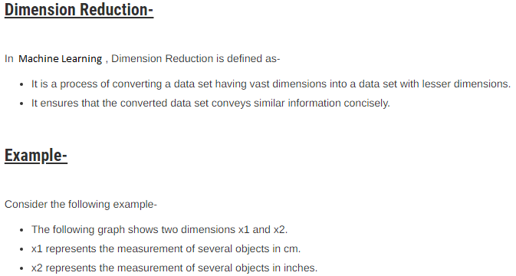

Slide 2
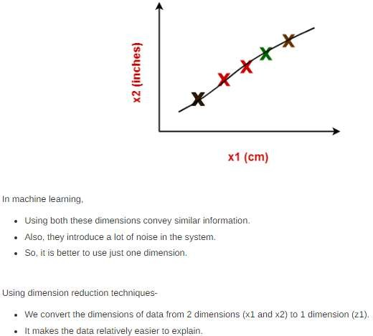

Slide 3
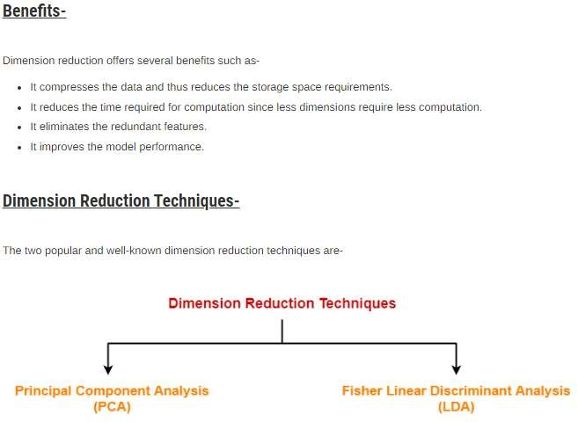

Slide 4
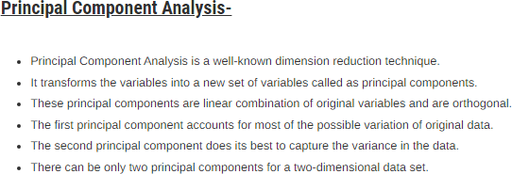
An orthogonal model means that all independent variables in that model are uncorrelated.
The term variance refers to a statistical measurement of the spread between numbers in a data set.
More specifically, variance measures how far each number in the set is from the mean and thus from
every other number in the set.
Variance is often depicted by this symbol: σ².

Slide 5
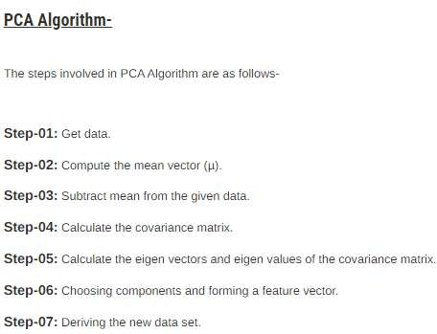
Covariance is a measure of how much two random variables vary together.
It's similar to variance, but where variance tells you how a single variable varies

Slide 6
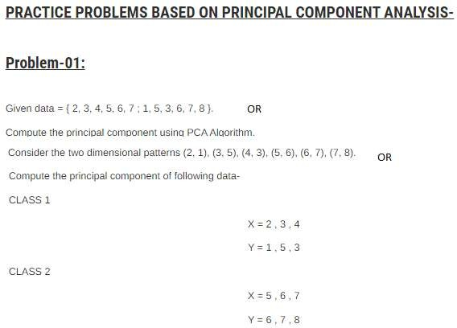

Slide 7
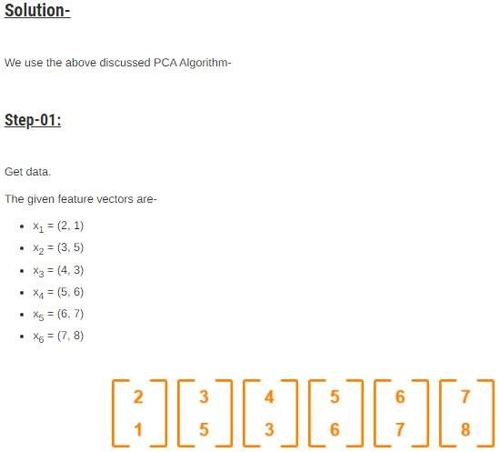

Slide 8
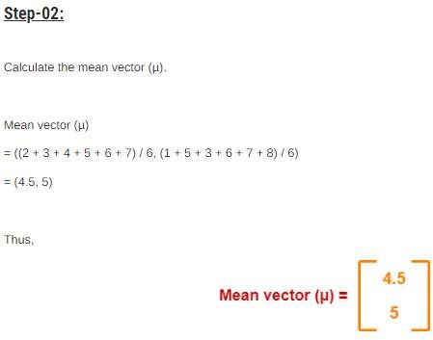

Slide 9
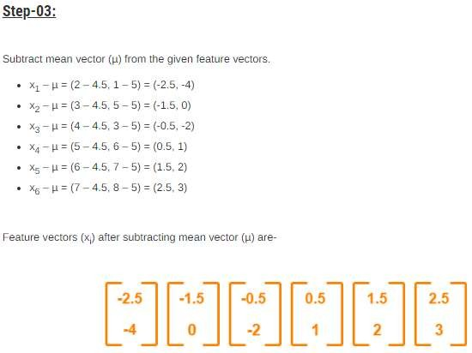

Slide 10
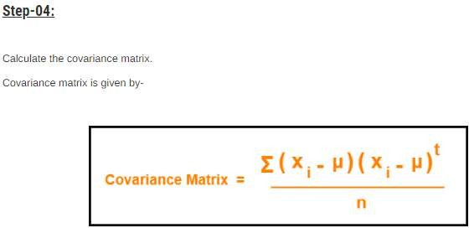
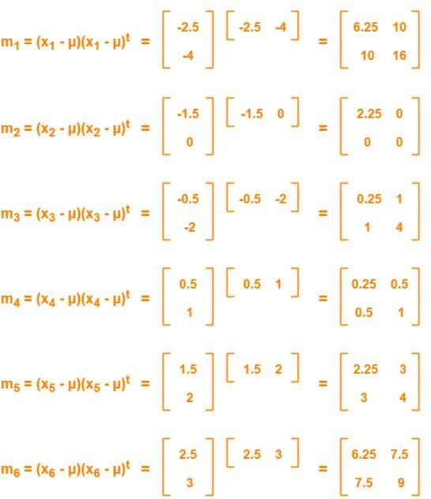

Slide 11
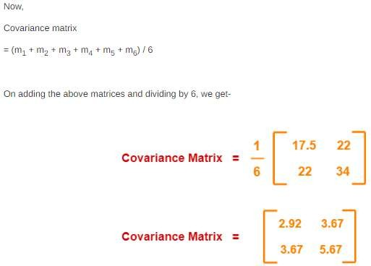

Slide 12
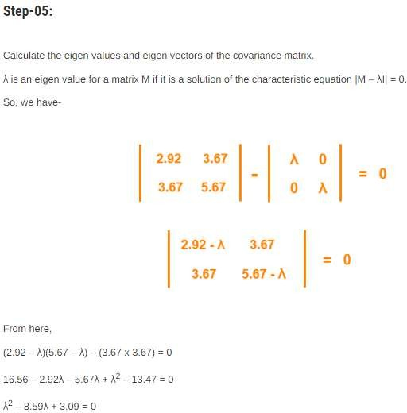

Slide 13
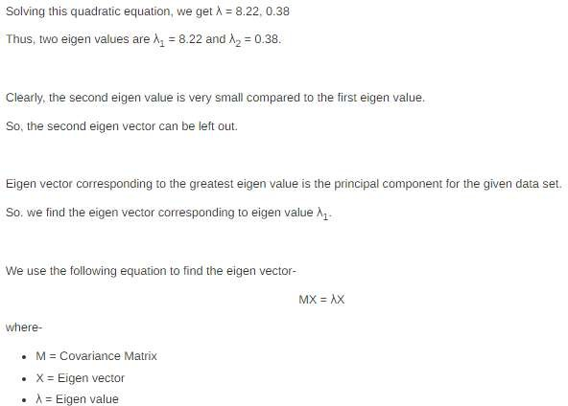

Slide 14
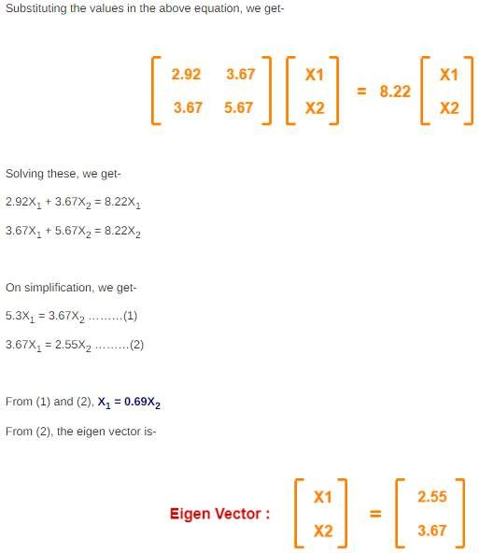

Slide 15


Slide 16
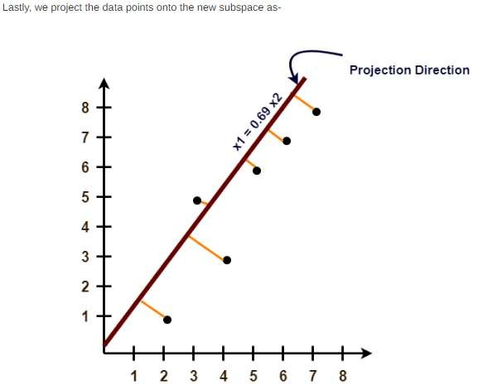

Slide 17
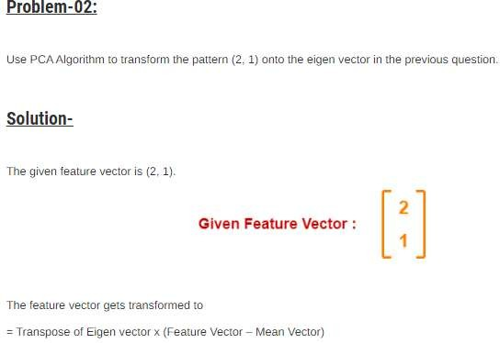
Hint

